Slide 1
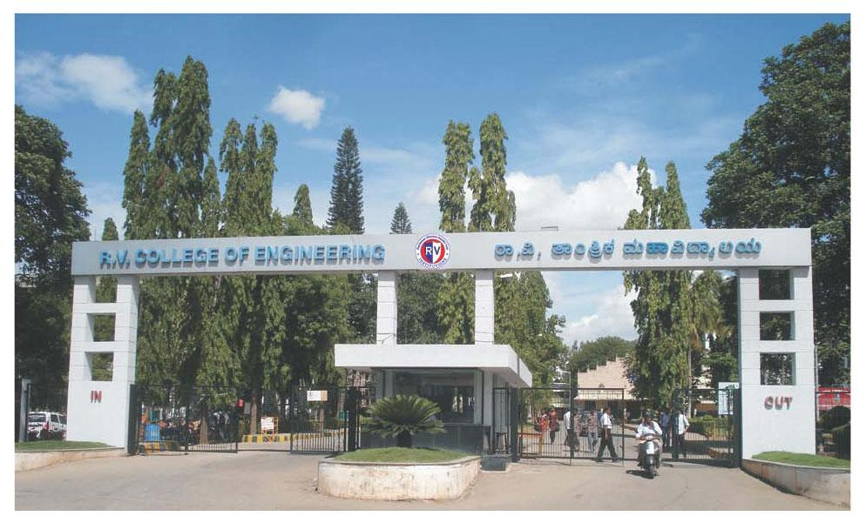
INTERDISCIPLINARY PROJECT (XX367P)
Topic : Real Time Cashew Kernel Classification Using Deep Learning

Slide 2
Team Details
Program | USN | Name
ECE | 1RV23EC408 | RAVIKANT
ECE | 1RV23EC410 | SAGAR T NAYAK
CSE | 1RV23CS405 | KIRAN H R
CSE | 1RV23CS407 | MANOJ KUMAR B V
BT | 1RV23BT404 | YOGEESH A S
Internal Guide
Dr. Veena Devi S .V
Associate Professor
Department of Electronics & Communication Engineering

Slide 3
INTRODUCTION
Cashew kernels are a valuable product in the global food market, and their quality affects both price and consumer choice. Traditionally, kernels are graded by hand based on size, shape, color, and surface condition. Skilled workers visually inspect and sort them into their respective grades.
However, manual grading is slow, tiring, and prone to mistakes, leading to inconsistencies in quality and profit loss. To solve this, the industry is moving toward automation using artificial intelligence and computer vision. Deep learning is especially useful because it can learn to recognize complex visual patterns from large sets of images.
This project focuses on developing a real-time system that automatically classifies cashew kernels using deep learning. It aims to replace manual inspection with a faster, more reliable, and scalable method, helping improve product quality, reduce labor needs, and boost overall efficiency in cashew processing.

Slide 4
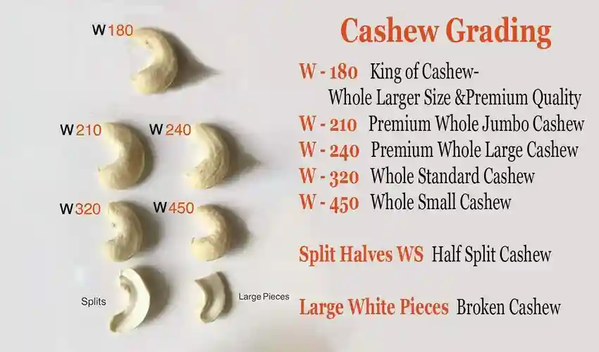
INTRODUCTION
Fig 1. Commercial Grades of the Cashew

Slide 5
LITERATURE SURVEY
Paper Title, Author & Publication | Summary | Key Findings | Research Gap
Title: A Low-Cost Deep-Learning-Based System for Grading Cashew Nuts. Authors:Van-Nam Pham,Quang-Huy Do Ba , Duc-Anh Tran Le , Quang-Minh Nguyen , Dinh Do Van .(2024) Journal:journal Computers, Volume 13, Issue 3, Article 71, in March 2024.(published by MDPI,Q2) | The paper introduces an affordable, automated system that employs deep learning to grade cashew nuts. By integrating YOLOv8 with Transformer models, the system classifies cashew nuts into four quality grades and utilizes an actuation mechanism for physical sorting. | YOLO v8, Transformer model offers 98.4% mAP and 2.96% error rate, outperforming baselines. supports cost-effective industrial cashew sorting. | Only focused on 4 types which include good, error1, error 2, error 3 Lack of real-time cashew grading systems on conveyors using low-cost cameras. Performance may vary based on the quality and specifications of the hardware used.

Slide 6
LITERATURE SURVEY
Paper Title, Author & Publication | Summary | Key Findings | Research Gap
Title: Precise Cashew Classification using Machine Learning Authors: Sowmya Nag Karnam, Veenadevi Siddanahundi Vaddagallaiah, Pradeep Kooganahalli Rangnaik, Akshaya Kumar, Charan Kumar, Bidadi Mahesh Vishwanath. Journal: Engineering, Technology & Applied Science Research, Vol. 14, No. 5, Oct. 2024(Q2) | The study evaluates deep learning models (YOLOv5, YOLOv9, CNN) for classifying cashews into five categories: whole, broken, split-up, split-down, and defect. YOLOv5 achieves 97.65% accuracy and 0.025 s inference time, making it ideal for real-time industrial applications. | YOLOv5 outperforms YOLOv9 and CNN with the highest accuracy (97.65%) and fastest inference time (0.025 s/image). Data augmentation enhances model robustness against variations in lighting and orientation. | It also lacks discussion on handling environmental factors like lighting variations or nut-splitting phenomena, which are critical for industrial deployment. Does not taken Hybrid model for case study only focused on 5 categories.

Slide 7
LITERATURE SURVEY
Paper Title, Author & Publication | Summary | Key Findings | Research Gap
Title: Implementation and Assessment of New Hybrid Model for Cashew Kernel Classification Authors: Sowmya Nag K. and Dr.Veenadevi S. V Journal: International Journal of INTELLIGENT SYSTEMS AND APPLICATIONS IN ENGINEERING. (11/03/2024)(Q4) | The paper proposes nine hybrid models combining CNNs (VGG16, ResNet50, InceptionV3) with machine learning (SVM, RF, KNN) for cashew classification. ResNet-50 + SVM achieved 97.40% accuracy, outperforming manual and existing methods, suitable for industrial usage. | ResNet-50 + SVM tops with 97.40% accuracy; VGG16 + RF at 95%, ResNet50 + RF at 90%. Outperformed prior works, with accuracies up to 96.8% from existing studies. | Lack real time implementation . Dataset Diversity: does not include images from various sources and conditions (e.g., different lighting, backgrounds) would enhance model robustness.

Slide 8
LITERATURE SURVEY
Paper Title, Author & Publication | Summary | Key Findings | Research Gap
Title: A Novel Approach to Cashew Nut Detection in Packaging and Quality Inspection Lines Authors: Van-Hung Pham, Ngoc-Khoat Nguyen, Van-Minh Pham Journal: International Journal of Advanced Computer Science and Applications (IJACSA), Volume 13, Issue 12, 2022(Q3) | The paper proposes YOLOv7 for detecting cashew nuts (good, broken, not peeled) in packaging lines. YOLOv7-tiny achieves high accuracy with 6.2M parameters, suitable for real-time quality inspection. | YOLOv7-tiny achieves high accuracy with 6.2M parameters, ideal for real-time cashew detection. CASHEW dataset ensures robustness across brightness and angles, enhancing detection reliability. | Lacks exploration of hybrid models combining YOLOv7 with techniques like CNN for improved accuracy. Does not address real-time conveyor-based sorting with low-cost hardware integration. does not include any market grading.

Slide 9
LITERATURE SURVEY
Paper Title, Author & Publication | Summary | Key Findings | Research Gap
Title:CashNet-15: An Optimized Cashew Nut Grading Using Deep CNN and Data Augmentation Authors:Sivaranjani, S. Senthilrani, B. Ashokumar, A. Senthil Murugan journal:Proc. Int. Conf. on Systems Computation Automation and Networking, 2019 | Introduces CashNet-15, a 15-layer deep CNN architecture with data augmentation for binary classification of cashew grades (whole vs others). Uses 8 convolutional, 4 max-pooling, 1 fully connected, activation, and dropout layers. Achieves 97.7% accuracy, outperforming prior methods. | Highest reported accuracy (97.7%) Employs data augmentation to reduce overfitting Custom CNN architecture optimized for the task Hyperparameter optimization (SGD with Beta, LReLU) | Only binary classification (whole vs others) Limited grade granularity Dataset size relatively small (1000 images) No direct multi-class extension Lack real time implimentation.

Slide 10
LITERATURE SURVEY
Paper Title, Author & Publication | Summary | Key Findings | Research Gap
Title:An Improvised Algorithm For Computer Vision Based Cashew Grading System Using Deep CNN Authors: Sivaranjani, S. Senthil Rani, B. Ashok Kumar, A. Senthil Murugan IEEE, 2019 | Proposes an improvised deep CNN-based framework for automated grading of cashew nuts, addressing the limitations of manual and traditional machine learning approaches. The system extracts features (shape, size, color, texture) automatically and optimizes CNN parameters for better classification. | Automates grading, reducing labor and subjectivity Deep CNN extracts features without manual intervention Incorporates optimization techniques (dropout, SGD, ReLU, transfer learning) Potential for high accuracy and scalability | Lacks experimental results or real-world deployment data No direct comparison with state-of-the-art deep learning models Future work needed to address multilabel and small dataset issues

Slide 11
MOTIVATION
The motivation behind this project arises from the need to address key challenges in kernel classification and sorting within the cashew processing industry.
Through an in-depth literature survey, it was observed that existing solutions often lack real-time performance, scalability, and seamless integration between detection and actuation.
To bridge this gap, we propose a comprehensive, real-time system that leverages YOLOv5s model for accurate Kernel grading, deployed on a Raspberry Pi for efficient edge inference.
The classification results are communicated to an Arduino Uno, which controls stepper motors for precise physical segregation of kernels. This integrated approach combines deep learning, edge computing, and automated actuation offering a practical and scalable solution that moves beyond theoretical research toward real-world deployment.

Slide 12
PROBLEM STATEMENT & OBJECTIVES
Problem Statement:
Despite advancements in automated cashew kernel grading using machine vision and deep learning, existing systems face challenges in real-time processing, hardware constraints, image quality, defect detection, and dataset limitations. These issues hinder the development of efficient, accurate, and scalable grading solutions, impacting product quality, labor efficiency, and profitability in the cashew processing industry.
Objectives:
Develop an image processing system to capture raw cashew kernel images and perform data preprocessing.(Data Collection)
Design and implement algorithms for feature extraction, data analysis, and classification of kernel variations.
Apply Deep Learning techniques to accurately detect, classify, and grade defects in cashew kernels.
Integrate reliable hardware and software components for efficient, real-time testing and grading.

Slide 13
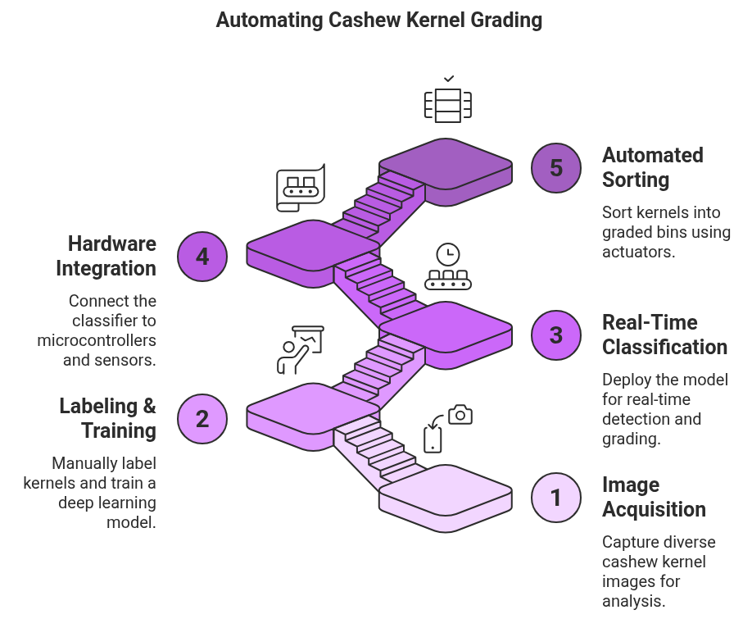
METHODOLOGY
Fig 2. Proposed Methodology

Slide 14
METHODOLOGY
Image Acquisition
Collect high quality images of cashew kernels under varying lighting, orientations, and backgrounds to ensure robustness.
Ensure class diversity by capturing images across all expected kernel grades and types to support effective model generalization.
Labeling and Training
Manually annotate images with the corresponding kernel grades using labeling tools to create a reliable training dataset.
Train a deep learning model (YOLOv5s) on this dataset to enable accurate detection and classification of kernels by grade.
Real Time Classification
Deploy the trained model on Raspberry pi to perform efficient, on-device interference.
Detect and classify kernels in real-time as they move through the processing line.

Slide 15
METHODOLOGY
Hardware Integration
Connect Raspberry pi output to arduino uno, which acts as an interface between the classifier and actuators.
Use sensors and motor drivers to synchronize detection signals with mechanical movements for accurate sorting.
Automated Sorting
Trigger stepper motors or actuators based on the classified grade to direct kernels into appropriate bins.
Achieve fully automated grading, reducing human error and increasing speed and consistency in the sorting process.

Slide 16
TOOLS & TECHNIQUES
Python : Core Model Development And Image Processing Task.
OpenCV : For image preprocessing, enhancement, and feature extraction(grades is size,Bounding box dimensions Aspect ratio (width vs height), sharp).
Albumentations: A fast and flexible Python library used to apply image augmentations like rotation, flipping, brightness changes, and noise to improve model robustness.
Annotation Tool Used
Platform: Roboflow
Annotation Type: Bounding Boxes
Export Format: YOLO v5 (.txt) format
Annotation Method: Manual drawing with class labels.
Raspberry Pi 4 : Compact single board computer used to run the model and to control hardware.
Web Cam(Microsoft lifecam): Used for Data Acquisition and also for capturing real time video for cashew grading.
Arduino Uno: Used to drive the motors for both conveyor belt and the actuators.
Stepper Motors and Motor Drivers(L298N): Used to precisely control the movement of sorting mechanisms based on classification output from the model.

Slide 17
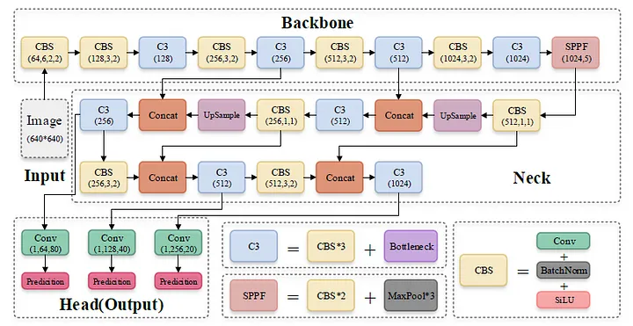
TOOLS & TECHNIQUES
Fig 3. YOLO v5s Architecture

Slide 18
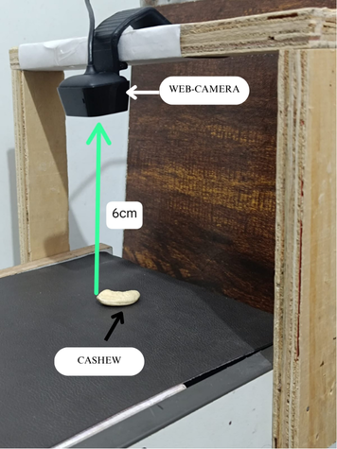
IMAGE/DATASET ACQUISITION
Dataset Development
Captured a substantial number of cashew kernel images using Microsoft Lifecam in varied lighting and orientations.
Images Captured
GRADES | NO. OF IMAGES | RESOLUTION
W180 | 474 | 1280X800
W500 | 473 | 1280X800
Fig 4. Image Capturing Setup

Slide 19
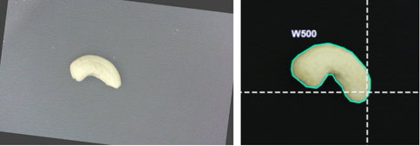
DATA PREPROCESSING
2. Image Preprocessing:
Initial preprocessing steps such as:
resizing ( resized to 640x640)
noise reduction
image enhancement
Data Augmentation
have been implemented to improve the quality of input data for Model Training .
Fig 5. Normal Image vs Annotated Image

Slide 20
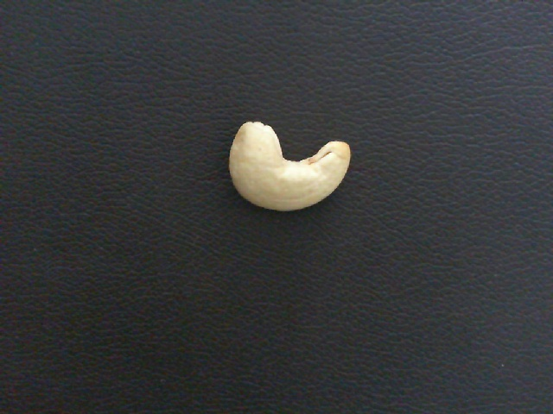

DATA PREPROCESSING
Noise Reduction
To enhance image quality and minimize unwanted artifacts, noise reduction was performed using the Gaussian filtering algorithm.
It applies a Gaussian function (a bell-shaped curve) to blur the image.
This is done by averaging each pixel's value with its neighbors, with closer pixels weighted more heavily.
It effectively removes high-frequency noise (random variation in brightness or color).

Slide 21
DATA PREPROCESSING
Image Enhancement:
It used to improve the visual quality of an image or make certain features more distinguishable for further analysis.
It helps in making key features (like cracks, textures, or object boundaries) more visible and easier to detect, especially in applications like cashew grading, medical imaging, or surveillance.

Slide 22
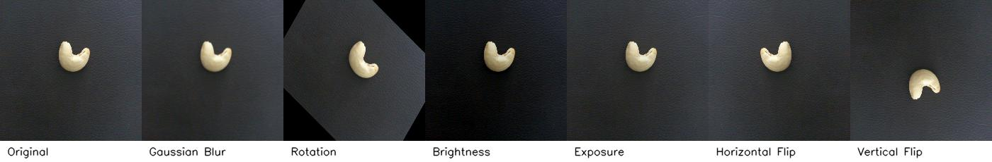
DATA PREPROCESSING
Augmentation Settings
Techniques Applied:
Blur: Gaussian blur applied up to 5 pixels
Rotation: Random angle between -45° to +45°
Brightness: Adjusted randomly between -25% to +25%
Exposure: Adjusted between -10% to +10%
Flip: Horizontal, Vertical
After Augmentation
Grades | No. of Images | Resolution
W180 | 1891 | 640 x 640
W500 | 1890 | 640 x 640

Slide 23
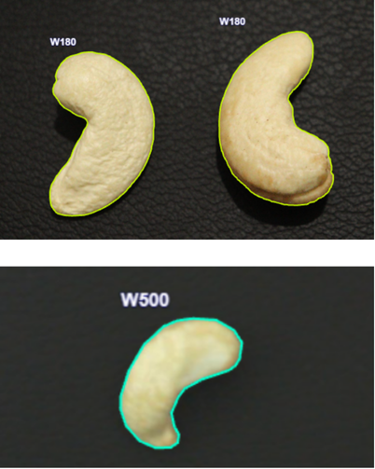
LABELING AND TRAINING
Manually annotated all images with the corresponding kernel grades using labeling tool called Roboflow to create a reliable training dataset
Fig 6. Sample Annotated images of the cashew grades

Slide 24
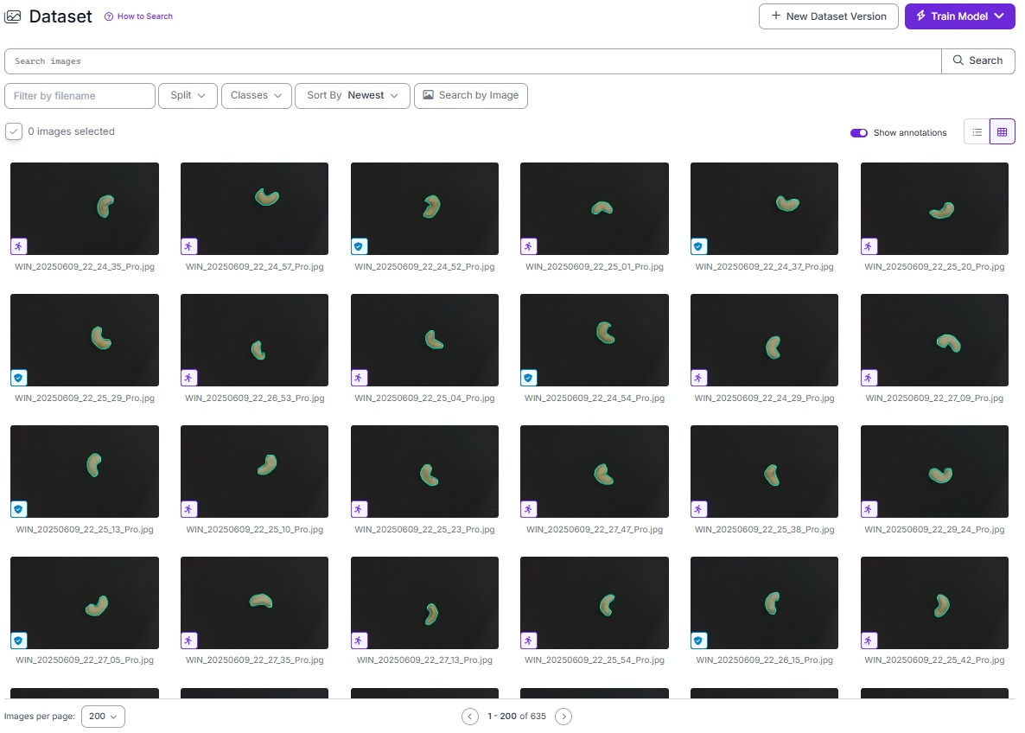
LABELING AND TRAINING
Fig 7. Annotated Dataset of the cashew grades

Slide 25
LABELING AND TRAINING
After dataset augmentation and Annotation , the model was trained under the following configuration to ensure optimal detection performance:
Image Size: 640 × 640
Epochs: 100
Batch Size: 16
Learning Rate: 0.01
Model Used: YOLOv5s

Slide 26
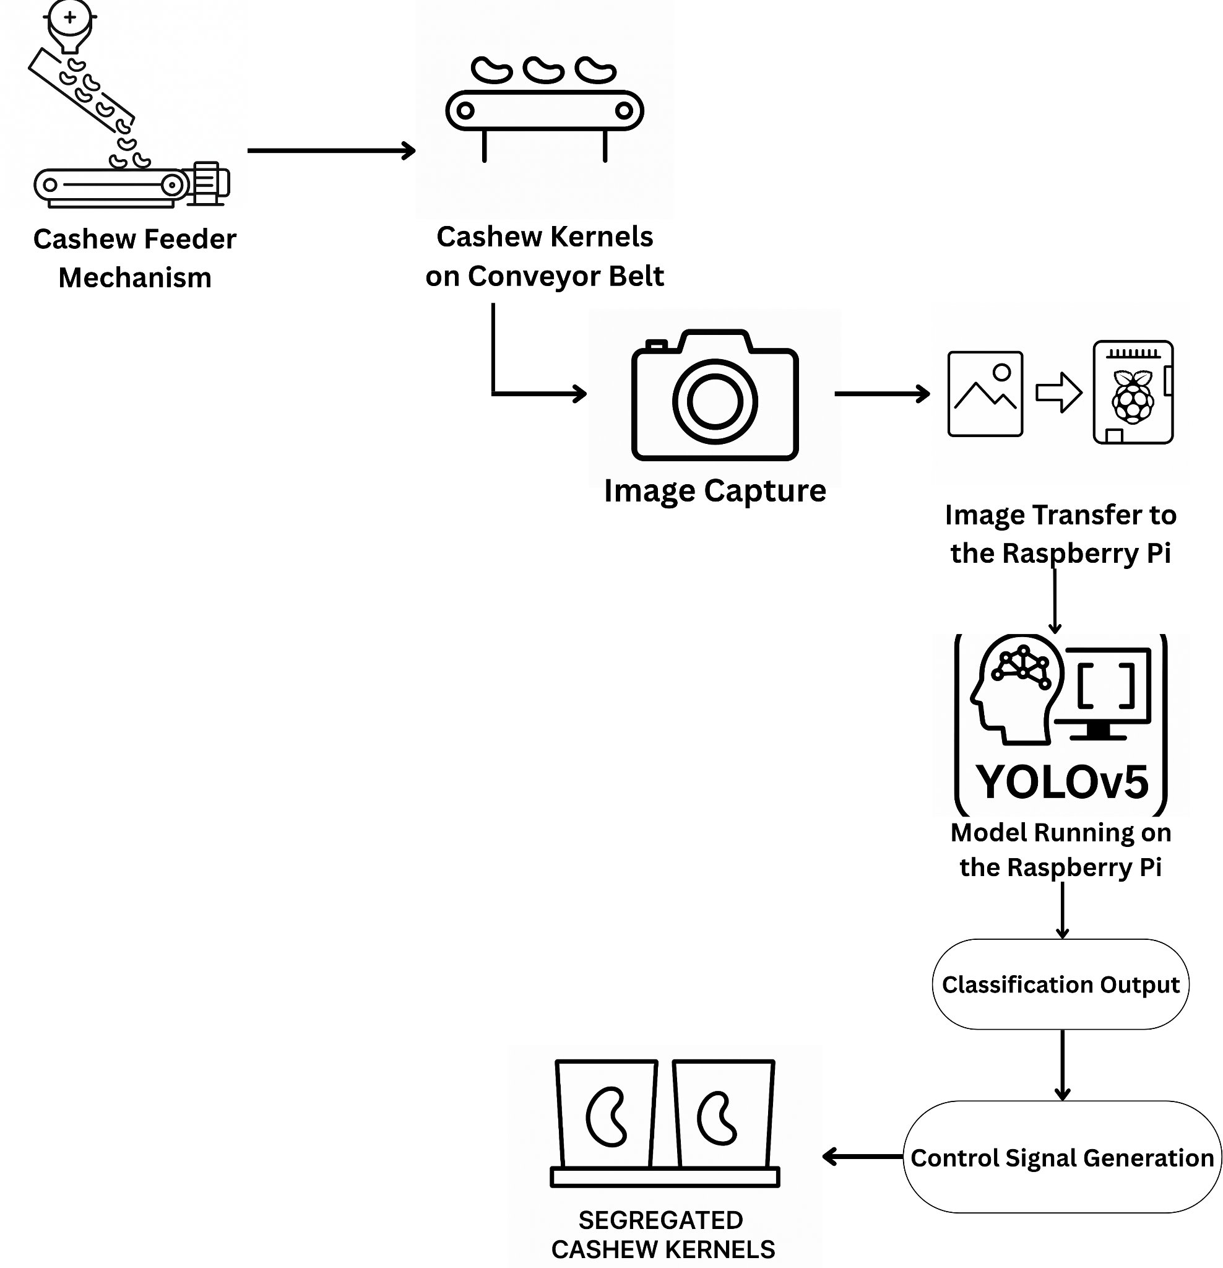
Block Diagram
Fig 8. System Architecture and Workflow of the Automated Cashew Kernel Sorting Model

Slide 27

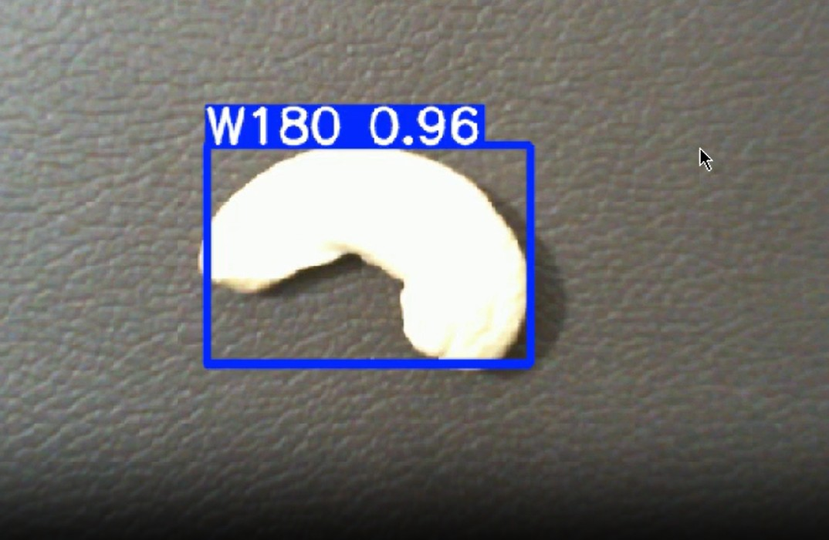
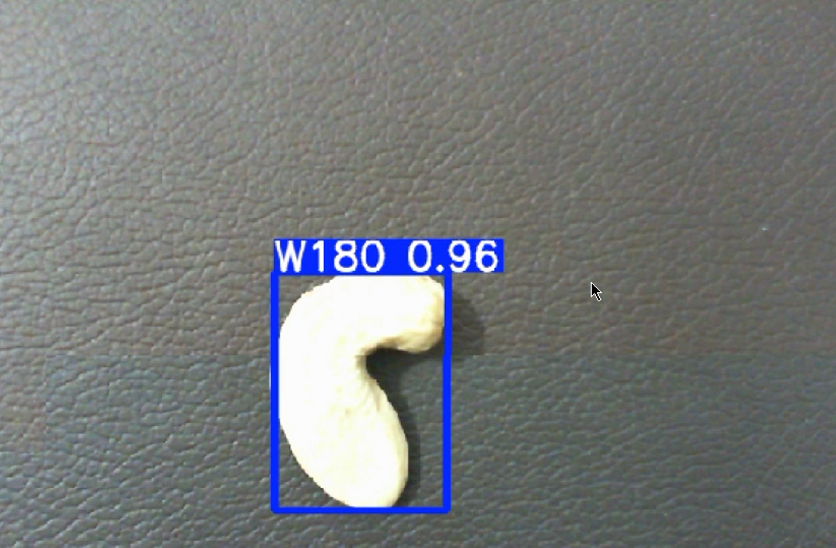
RESULTS
Fig 9. Model Classification Output of grade W180 grade

Slide 28
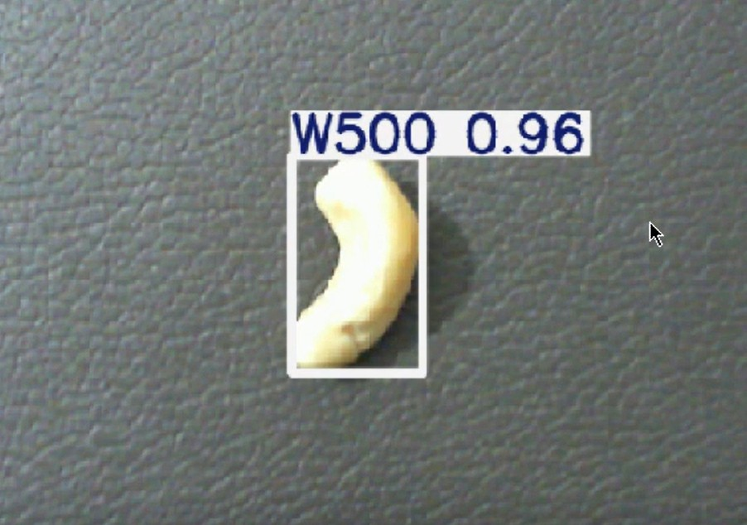
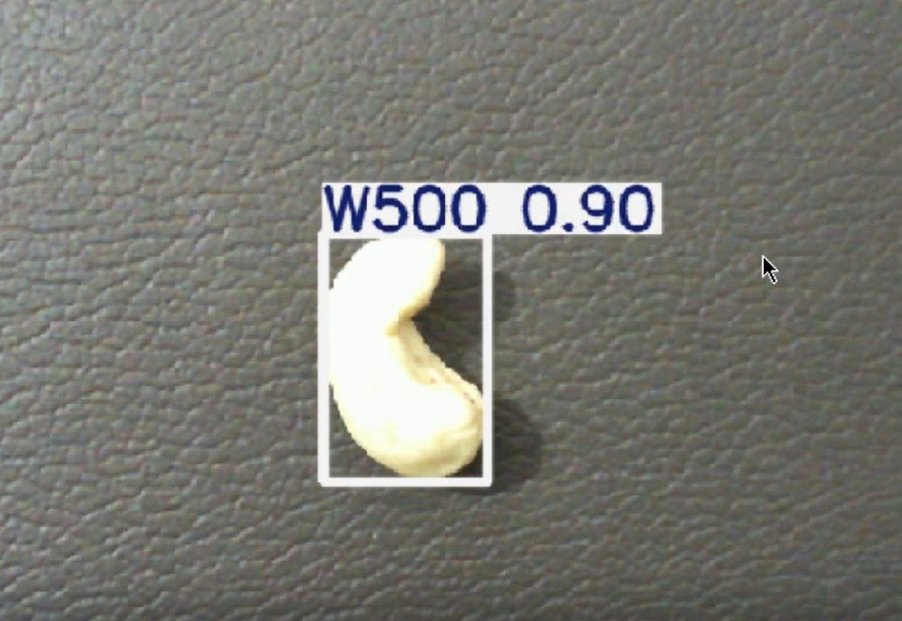
RESULTS
Fig 10. Model Classification Output of grade W500

Slide 29
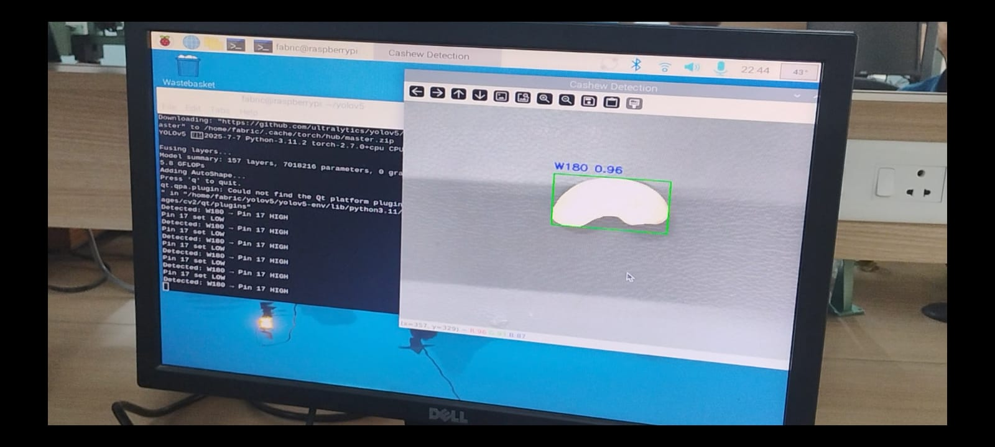
RESULTS
Fig 11. Live Cashew kernel classification on Raspberry pi

Slide 30
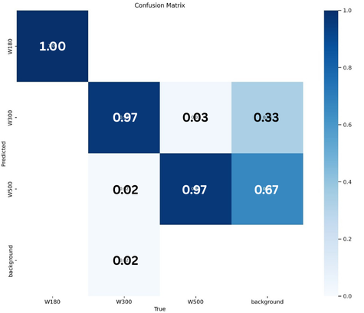
CONFUSION MATRIX
Confidence and Precision - Recall Analysis
The confusion matrix illustrates clear and balanced classification across all three kernel grades: W180, W300 and W500.
Diagonal dominance in the matrix confirms high true positive predictions for all classes.
Minor confusion observed:
A few W300 kernels misclassified as W500, likely due to close visual similarity in size/shape.
Overall distribution remains well-separated, reflecting good inter-class distinction by the model.
This analysis confirms the model’s robustness in multi-class detection tasks with minimal class confusion.
Fig 12. Confusion Matrix

Slide 31
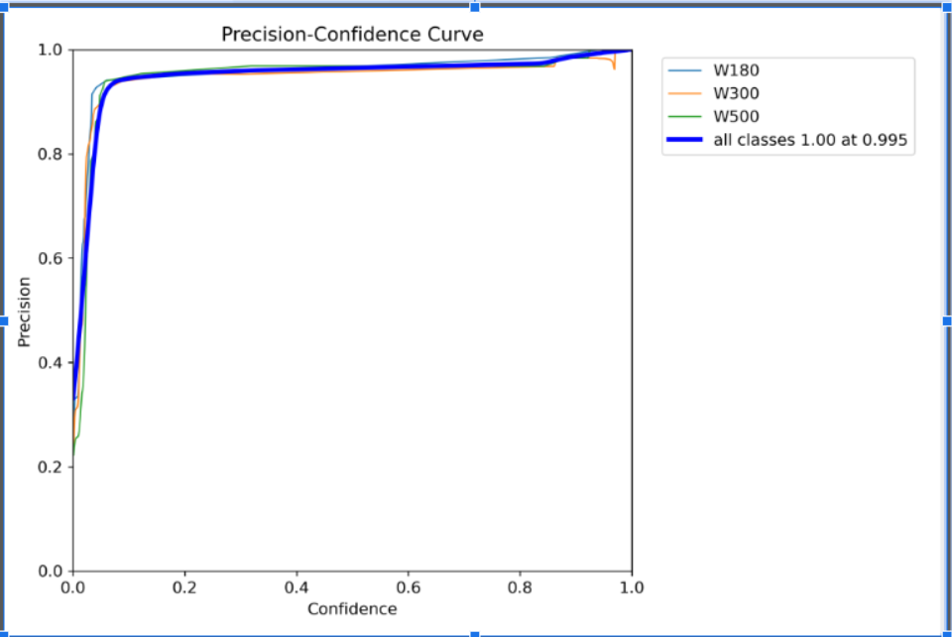
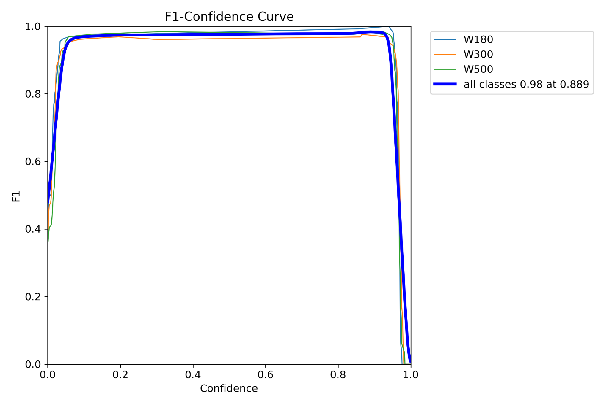
Results & Discussion
Confidence and Precision Recall Analysis
Fig 13. Precision - Confidence Curve
Fig 14. F1 - Confidence Curve

Slide 32
Results & Discussion
Confidence and Precision - Recall Analysis
F1–Confidence Curve:
Peaks at a confidence threshold of 0.89, achieving an F1 Score close to 0.98.
Indicates optimal balance between precision and recall at that threshold.
Precision–Confidence Curve:
Shows near-perfect precision (~1.00) at a threshold of 0.995.
Indicates very low false positives at high confidence levels.

Slide 33
CONCLUSION
Developed a real-time Deep Learning-based system for cashew kernel grading and sorting using YOLO V5s on Raspberry Pi 4.
Achieved over 95% accuracy with precise physical segregation via Arduino-controlled flaps.
Offers a low-cost, scalable, and efficient solution for automating cashew processing, enhancing productivity and grading consistency.
Sets the foundation for further industrial automation in agro-processing.

Slide 34
FUTURE SCOPE
Expand grading to include more kernel types like W210, W240, and defective classes.
Enable dynamic dataset generation for adaptive learning in real environments.
Integrate edge AI accelerators (e.g., Jetson Nano) for faster, parallel processing.
Add sensor feedback for error detection and real-time monitoring dashboards.
Support bulk sorting using conveyors and object tracking (e.g., Deep SORT).
Implement data logging for traceability and quality assurance in exports.

Slide 35

QR Code for Video Demo and Other Project Documents

Slide 36
REFERENCES
[1]. A. M. O. Arun, G. N. Aneesh, and A. Shyna, “Automated cashew kernel grading using machine vision,” in Proc. Int. Conf. Next Generation Intelligent Systems (ICNGIS), 2018, pp. 1–6. doi: 10.1109/ICNGIS.2016.7854063.
[2]. A. Shyna and R. M. George, “Machine vision based real time cashew grading and sorting system using svm and back propagation neural network,” in Proc. Int. Conf. Circuits Power and Computing Technologies (ICCPCT), 2017, pp. 1–4. doi: 10.1109/ICCPCT.2017.8074385.
[3]. A. Sivaranjani, S. Senthilrani, B. Ashokumar, and A. S. Murugan, “An improvised algorithm for computer vision based cashew grading system using deep cnn,” in Proc. IEEE Int. Conf. Current Trends in Advanced Computing (ICCTAC), 2019, pp. 1–6.
[4]. A. Sivaranjani, S. Senthilrani, B. Ashokumar, and A. S. Murugan, “Cashnet-15: An optimized cashew nut grading using deep cnn and data augmentation,” in Proc. Int.Conf. Systems Computation Automation and Networking (ICSCAN), 2019, pp. 1–6
[5]. V.-N. Pham, Q.-H. D. Ba, D.-A. T. Le, Q.-M. Nguyen, D. D. Van, and L. Nguyen, “Alow-cost deep-learning-based system for grading cashew nuts,” Computers, vol. 13, no. 3, p. 71, 2024.
[6]. S. N. Karnam, V. S. Vaddagallaiah, P. K. Rangnaik, A. Kumar, C. Kumar, and B. M. Vishwanath, “Precise cashew classification using machine learning,” Engi neering, Technology & Applied Science Research, vol. 14, no. 5, pp. 17414–17421, 2024. doi: 10.48084/etasr.8052.
[7]. M. A. and P. N. Renjith, “Classification of durian fruits based on ripening with machine learning techniques,” in Proc. Int. Conf. Intelligent Sustainable Systems (ICISS), 2020, pp. 542–547.

Slide 37
REFERENCES
[8]. S. E. Sunday, R. Ji, A. N. Abdalla, and H. Bian, “Fruit image classification using the inception-v3 deep learning model,” in Proc. Int. Conf. Cognitive Computing and Complex Data (ICCD), 2023, pp. 227–230. doi: 10.1109/ICCD59681.2023. 10420760.
[9]. V. Gautam, R. G. Tiwari, A. Misra, D. Witarsyah, N. K. Trivedi, and A. K. Jain, “Dry fruit classification using deep convolutional neural network trained with transfer learning,” in Proc. Int. Conf. Advancement in Data Science, E-learning and Information System (ICADEIS), 2023, pp. 1–6. doi: 10.1109/ICADEIS58666.2023. 10270982.
[10]. R. Raj, S. S. Nagaraj, S. Ritesh, T. A. Thushar, and V. M. Aparanji, “Fruit classi f ication comparison based on cnn and yolo,” in IOP Conf. Ser.: Mater. Sci. Eng., vol. 1187, 2021, p. 012031.
[11]. P. Nirale and M. Madankar, “Analytical study on iot and machine learning based grading and sorting system for fruits,” in Proc. Int. Conf. Computational Intelligence and Computing Applications (ICCICA), 2021, pp. 1–6. doi: 10.1109/ ICCICA52458.2021.9697161.
[12]. R. Rico, M. Bullo, and J. Salas-Salvado, “Nutritional composition of raw fresh cashew (anacardium occidentale l.) kernels from different origin,” Food Science & Nutrition, vol. 4, no. 2, pp. 329–338, 2015.
[13]. T. Akinhanmi, V. Atasie, and P. Akintokun, “Chemical composition and physicochemical properties of cashew nut (anacardium occidentale) oil and cashew nut shell liquid,” Journal of Agricultural, Food and Environmental Sciences, vol. 2,no. 1, pp. 1–10, 2008.
[14]. D. Balasubramanian, “Postharvest technology: Physical properties of raw cashew nut,” Journal of Agricultural Engineering Research, vol. 78, no. 3, pp. 291–297, 2001.

Slide 38
REFERENCES
[15]. J. Tyman, R. Johnson, M. Muir, and R. Rokhgar, “The extraction of natural cashew nut shell liquid from the cashew nut (anacardium occidentale),” J. Am. Oil Chemists’ Soc., vol. 66, no. 4, pp. 553–557, 1989
[16]. S. K.G.Srivastava and V. Meharwade, Cashew Handbook 2014– Global Perspective. 2014.
[17]. T. T. F. Saeed, H. Bader, B. Niaz, M. A. Fzaal, A. Din, and H. A. R. Suleria, “Cashew nut allergy: Immune health challenge,” Trends in Food Science & Tech nology, vol. 86, pp. 209–216, 2019.
[18]. B. Gon¸calves et al., “Composition of nuts and their potential health benefits—an overview,” Foods, vol. 12, p. 942, 2023. doi: 10.3390/foods12050942.
[19]. R. Singh, P. Karthikeyan, and R. Anand, “Sc3t: A low-cost transformer-enhanced deep learning architecture for real-time cashew kernel grading on edge devices,” Computers and Electronics in Agriculture, vol. 215, p. 108274, 2024. doi: 10. 1016/j.compag.2024.108274
[20]. A. Mishra and S. Awasthi, “Hybrid deep learning and svm model for grading of cashew kernels using resnet-50 features,” Journal of Food Engineering, vol. 349, p. 111395, 2024. doi: 10.1016/j.jfoodeng.2024.111395.
[21]. Y. Li, H. Zhou, and J. Wang, “Lightweight shape-based svm classifier for whole and split cashew kernel detection,” Journal of Imaging, vol. 9, no. 11, p. 198, 2023. doi: 10.3390/jimaging9110198.

Slide 39


